Slide 1

3D Printing of Magnetic
Multi-Material Hydrogels
IIB Project Midterm Presentation ~ Nanoscience Centre, Cambridge
Supervised by Yaqi Sheng and Shery Huang
By Lorcan Nicholls ~ ln356@cam.ac.uk
‹#›
Notes:
Good Morning. I am Lorcan and these are my groupmates, Kayoon and Jaime.

Slide 2






Presentation Outline
Introduction
Project Goals
Theory
Practical Methods
Practical Methods
Results
Work To Do
Notes:
Here's a brief itinerary, I will go over the theory behind the paper as well as some applications later on, Kayoon will discuss an overview of the paper and the practical methods used, and Jaime will give the results and some conclusions of the research.

Slide 3
Introduction
What is the project?
What’s in the literature so far?
Introduction
Project Goals
Theory
Procedures
Results
Work To Do
‹#›
Notes:
So let's start by unpacking the technical terms in the title first.

Slide 4
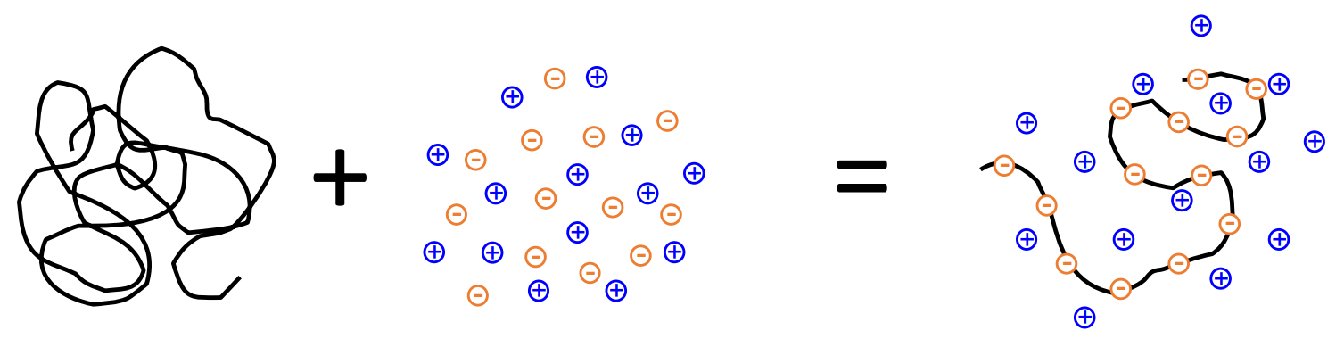
Responsive Hydrogels
Materials that deform under external stimuli
Biopolymer Aqueous Sensorised Hydrogel
Electrolyte (Polyelectrolyte)
Hydrogels are highly flexible, biocompatible, bioresorbable materials.
They are used extensively as scaffold materials in bioprinting applications.
Introduction
Project Goals
Theory
Procedures
Results
Work To Do

Slide 5
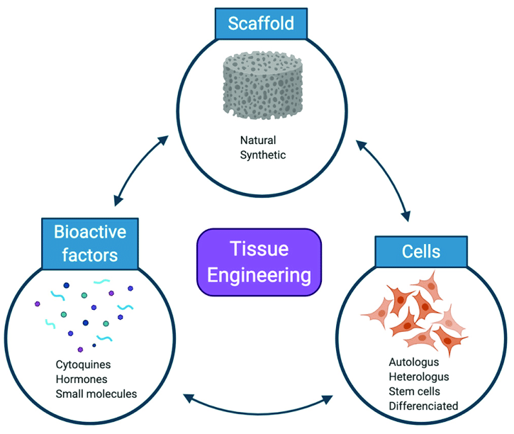
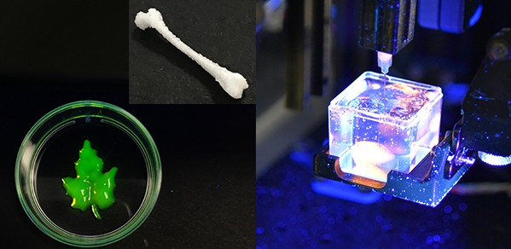
Regenerative Medicine & Tissue Engineering
Implants that become part of a person’s natural tissues over time
Shery’s group has already built a 3D bioprinter (Printer.HM) for extruding soft materials in the Nanoscience centre.
Introduction
Project Goals
Theory
Procedures
Results
Work To Do

Slide 6
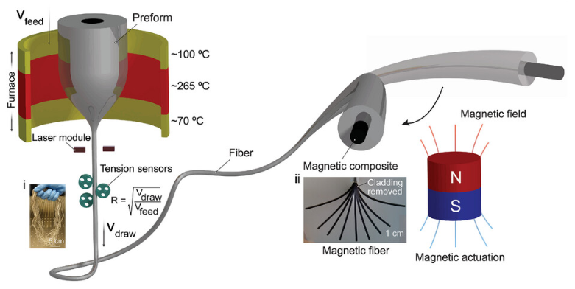
Actuation of Implants
Uses magnetic fibre composites to move the hydrogel remotely
Thin magnetic fibres deform in the presence of an electromagnet.
A hydrogel in contact with the fibres is constrained to move with it.
Since the stiffness of the fibres is much higher than the stiffness of the hydrogel, the fibres are able to push the hydrogel into a shape that we can control.
Introduction
Project Goals
Theory
Procedures
Results
Work To Do

Slide 7
Project Goals
Optimise and synthesise the magnetic fibres
Print and integrate the hydrogel composite
Test mechanical properties of the system
Introduction
Project Goals
Theory
Procedures
Results
Work To Do
‹#›
Notes:
So let's start by unpacking the technical terms in the title first.

Slide 8


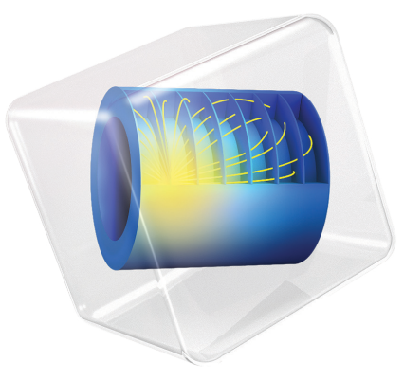

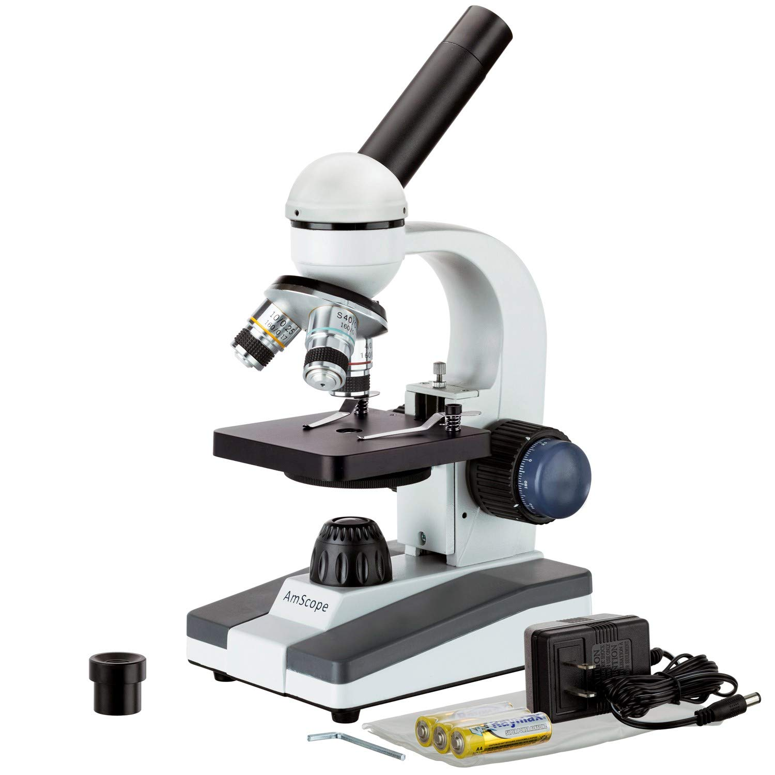
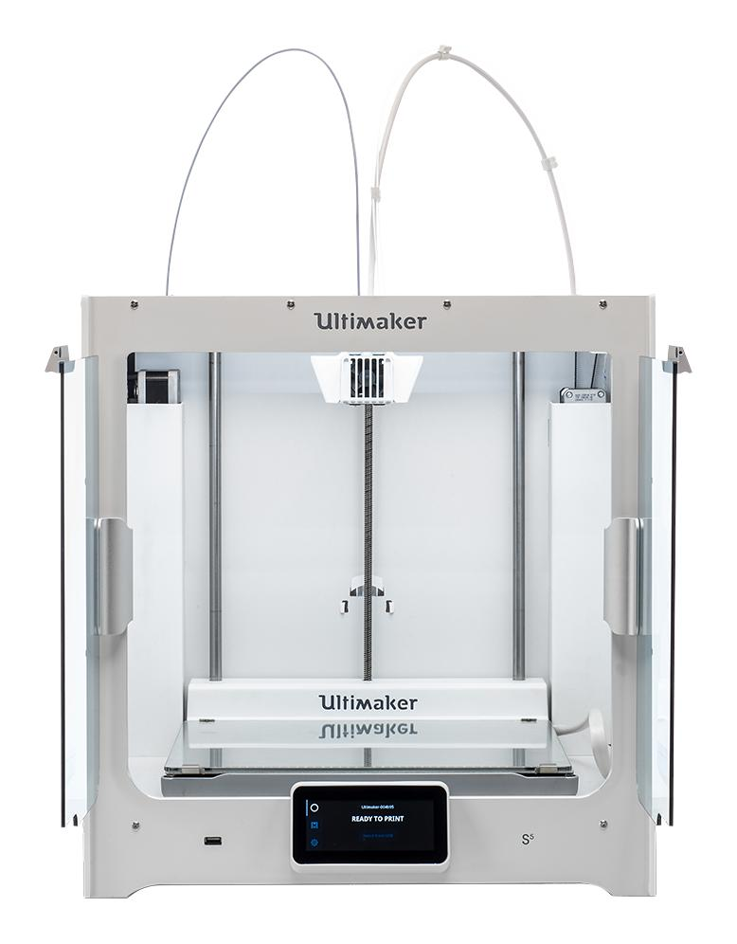
Michaelmas - Magnetic Fibres
Ansys Granta Solidworks Comsol Cura Microscopy 3D Printing
Perform structural analysis, material selection and computational modelling
Make different compositions of magnetic fibres
Aim to find the stiffest material that can deform under a magnetic load
Introduction
Project Goals
Theory
Procedures
Results
Work To Do
Notes:
The novel part about this paper is that the authors engineer ArMs to evolve enantioselectivity and higher activity through combination of random mutagenesis and target mutagenesis

Slide 9
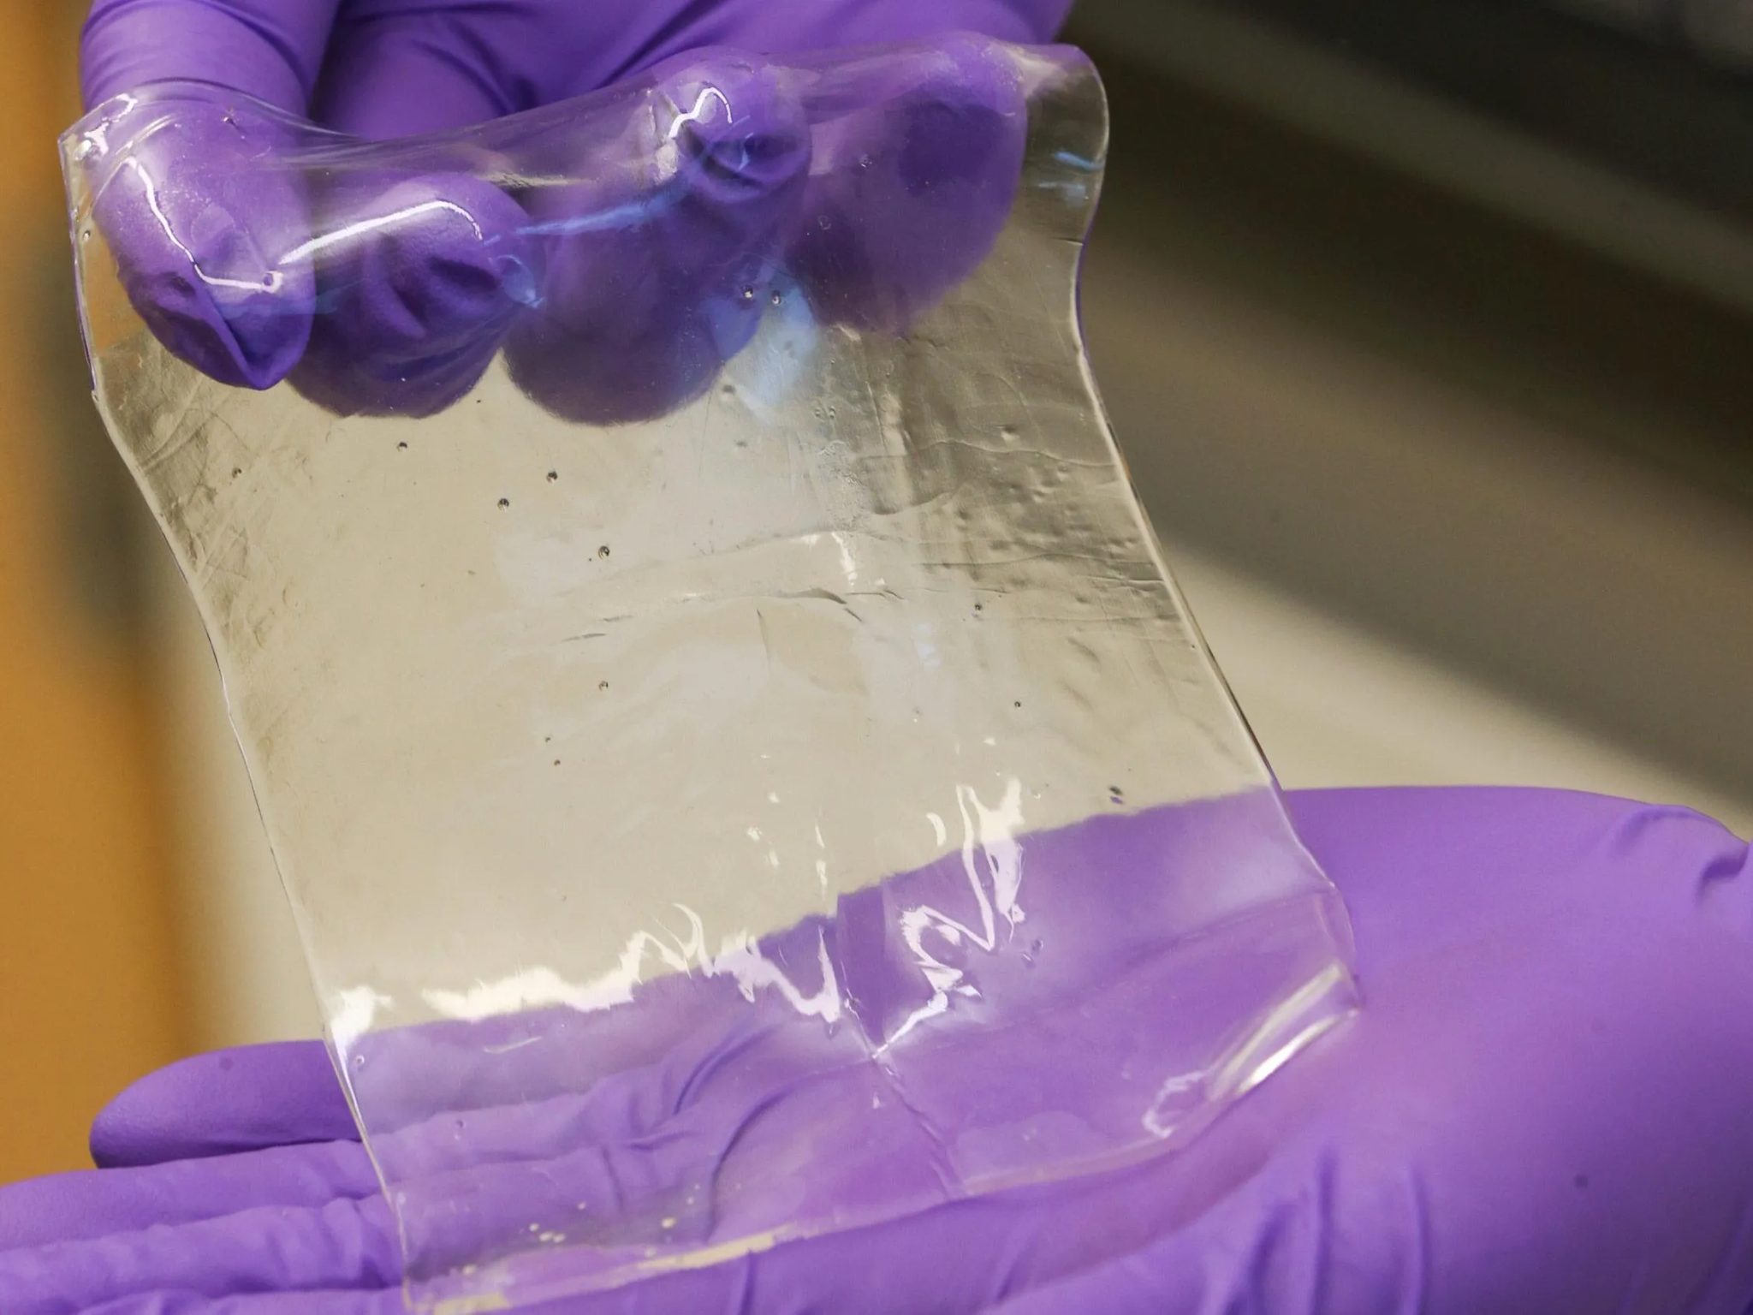
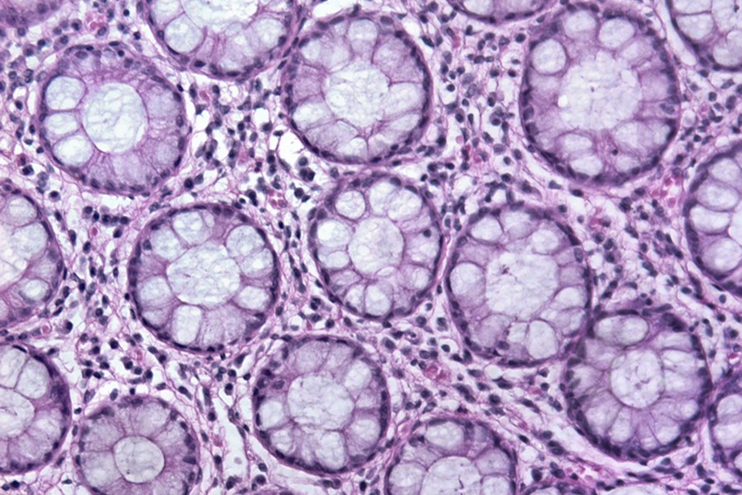
Lent and Easter - Hydrogel Printing
Forming and Testing the Hydrogel Composite
Lent
Synthesise a biocompatible hydrogel
Use Printer.HM to print the hydrogel onto the best magnetic fibres
Measure flexibility of the system with an electromagnet
Easter
Print a model tissue with epithelial cell culture
Demonstrate in vitro actuation of the tissue with an electromagnet
Introduction
Project Goals
Theory
Procedures
Results
Work To Do
Notes:
The novel part about this paper is that the authors engineer ArMs to evolve enantioselectivity and higher activity through combination of random mutagenesis and target mutagenesis

Slide 10
Theory
Simulate the Fibres
Select the Best Materials
Introduction
Project Goals
Theory
Procedures
Results
Work To Do
‹#›
Notes:
So let's start by unpacking the technical terms in the title first.

Slide 11
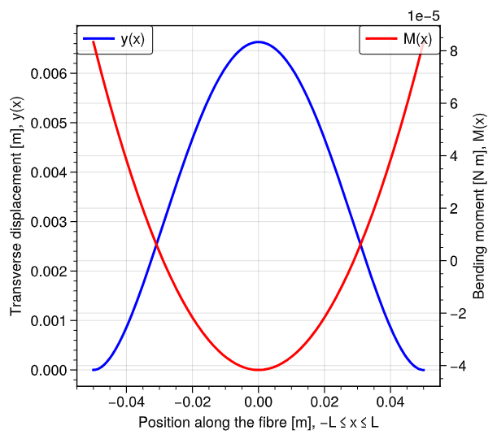
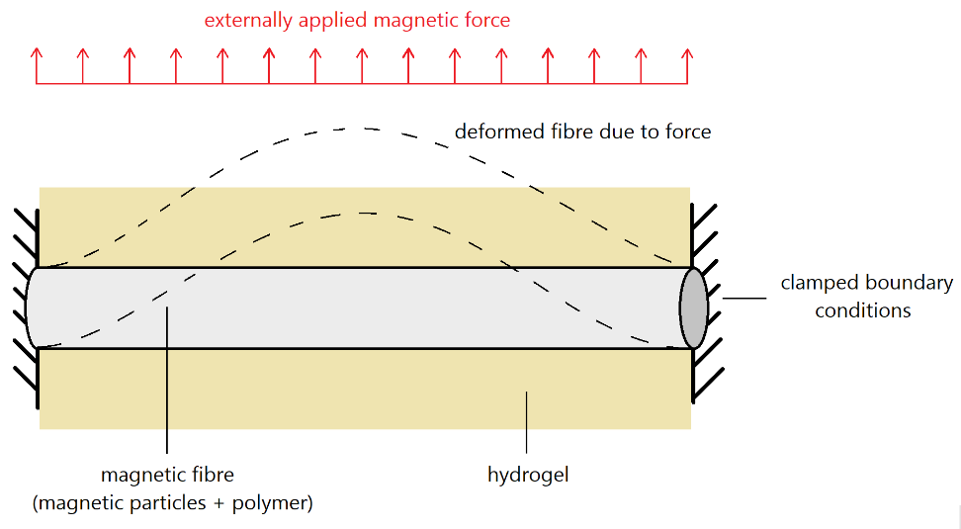
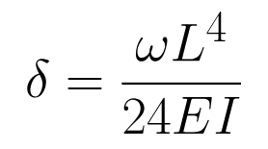
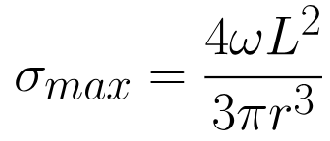
Structural Modelling and Analysis
Setting Up the Model of a Fibre
Introduction
Project Goals
Theory
Procedures
Results
Work To Do
‹#›
Notes:
So let's start by unpacking the technical terms in the title first.

Slide 12
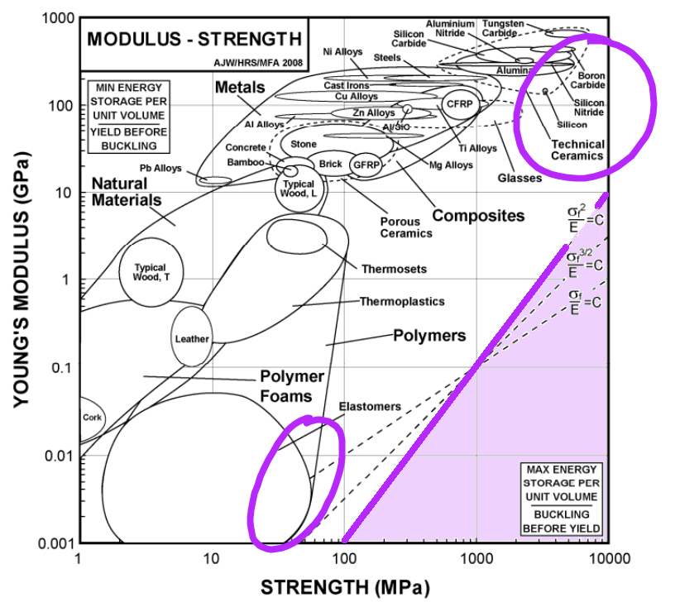
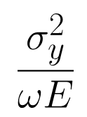
Material Selection
Trade-Offs Between Stiffness and Magnetisation
This is a stiffness-limited design material selection problem.
Performance Index: maximise
σ_{y} [Pa]: fibre yield stress
E [Pa]: fibre Young’s modulus
ω [N m⁻¹]: magnetic force per unit length
Introduction
Project Goals
Theory
Procedures
Results
Work To Do
‹#›
Notes:
So let's start by unpacking the technical terms in the title first.

Slide 13
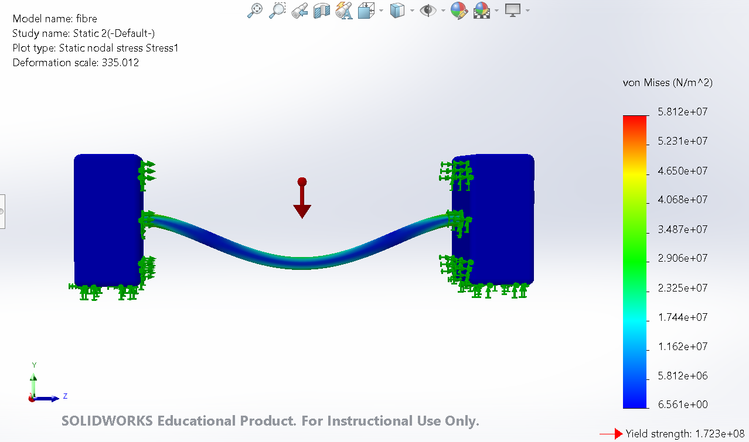
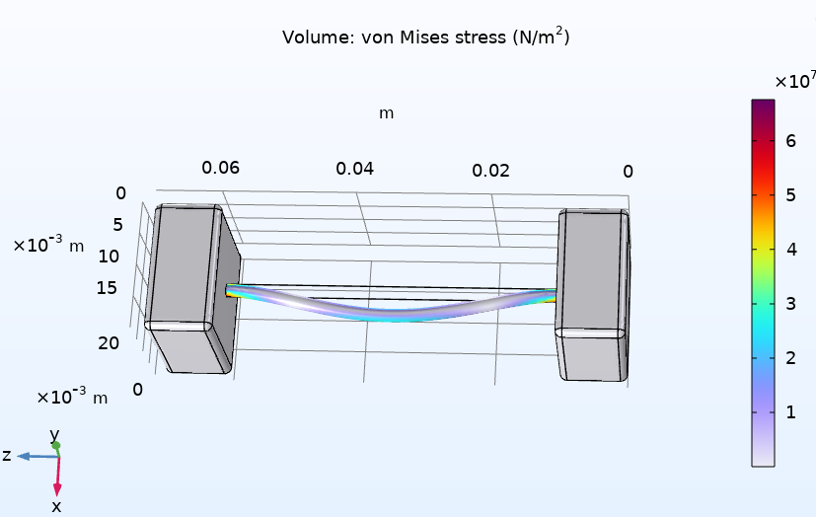
Computational Modelling
Useful for Checking Order-of-Magnitudes of Properties
SOLIDWORKS: simple setup
COMSOL Multiphysics: simulation
Introduction
Project Goals
Theory
Procedures
Results
Work To Do
‹#›
Notes:
So let's start by unpacking the technical terms in the title first.

Slide 14
Procedures
Make Magnetic Polymer Solution
Program Spinner
Extrude Fibres
Observe Under Microscope
Assess Quality and Deformation
Introduction
Project Goals
Theory
Procedures
Results
Work To Do
‹#›
Notes:
So let's start by unpacking the technical terms in the title first.

Slide 15
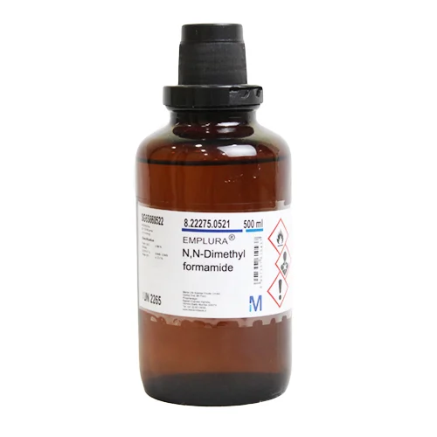
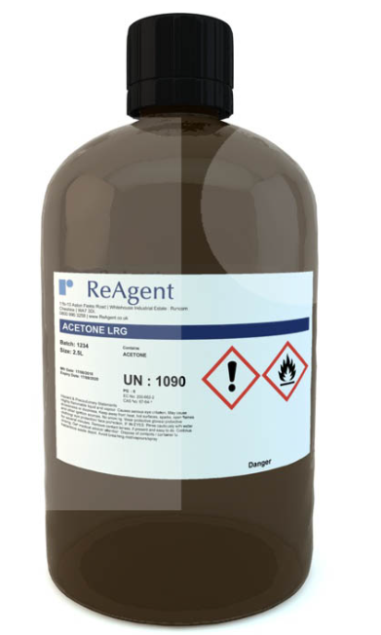
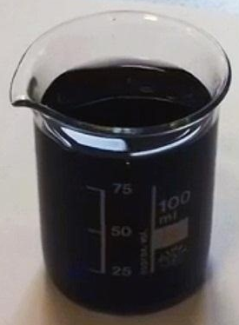
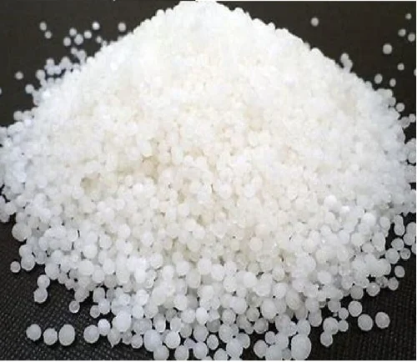
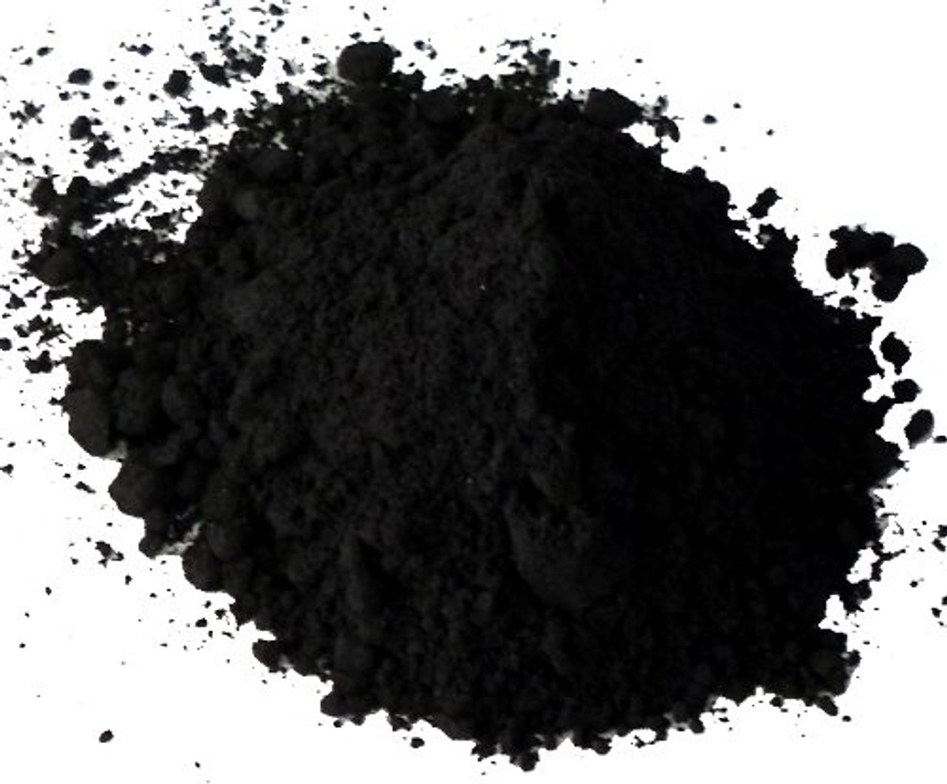

Fibre Composition
Solvent + Polymer + Magnetic Powder → Magnetic Solution
+
+
+
→
Iron oxide
(iron(II, III) oxide)
sets magnetism
Magnetic solution
DMF
(N,N-dimethylformamide)
85% weight
Acetone
(propanone)
15% weight
Polystyrene
sets viscosity
30% weight
Spin-ready
Solvent
Polymer
Magnets
We may also use PEO (polyethylene oxide) as the polymer.
Introduction
Project Goals
Theory
Procedures
Results
Work To Do
Notes:
So let's start by unpacking the technical terms in the title first.

Slide 16
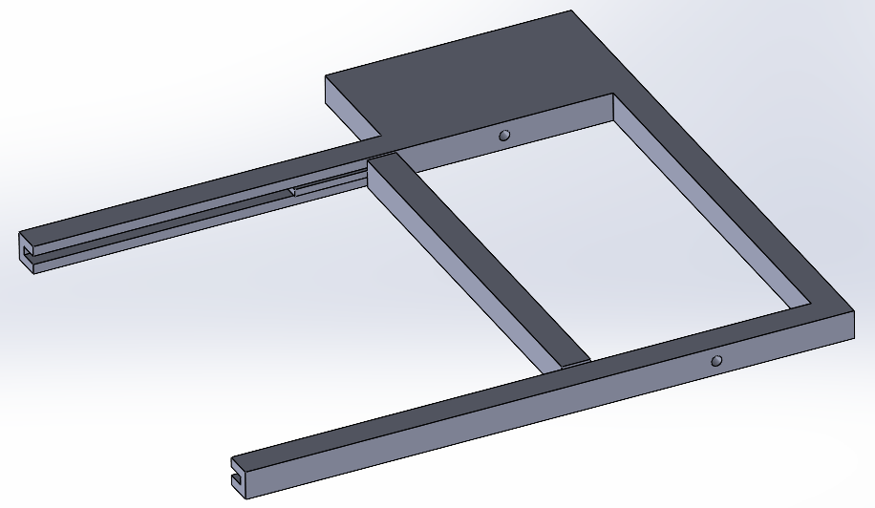
Spinning the Fibres
3D Print a Moveable Frame, Spin with Robot Arm and Pump
A robotic arm is programmed to hold a syringe containing the magnetic solution
A calibrated pump extrudes the solution through the syringe at a steady rate while the robot arm moves along the frame
An Arduino microcontroller rotates the frame, winding the fibre around the frame
The fibres can then be examined under a light microscope
The deflection under a magnet can be measured with varying iron content
Introduction
Project Goals
Theory
Procedures
Results
Work To Do
Notes:
So let's start by unpacking the technical terms in the title first.

Slide 17
Results
Suitability of Fibre Solution
Spinnability
Achievable Length Scales
Introduction
Project Goals
Theory
Procedures
Results
Work To Do
‹#›
‹#›
Notes:
So let's start by unpacking the technical terms in the title first.

Slide 18
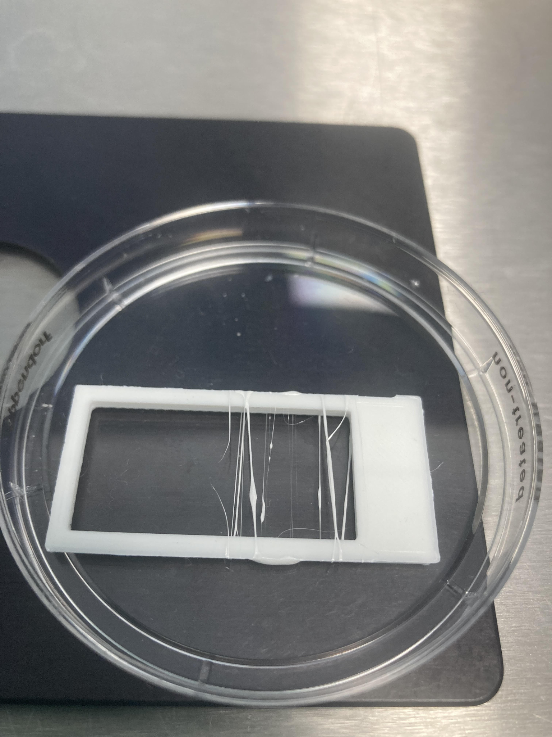
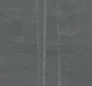
Qualitative Spinnability
Some Compositions Work Better Than Others
Our PEO-based solutions did not produce spinnable solutions.
Using polystyrene gave spinnable fibres in all iron proportions with varying viscosity.
Distance between fibres ~ 1 mm
Thickness of fibres ~ 10+ μm
Introduction
Project Goals
Theory
Procedures
Results
Work To Do
‹#›
Notes:
Now let's go through some of the applications of artificial metalloenzymes. Since natural enzymes are found in a variety of exciting biotechnology applications, we can design artificial enzymes to carry out reactions that do no occur naturally, which has applications in pharmacology, medicine, sustainability and biology.

Slide 19
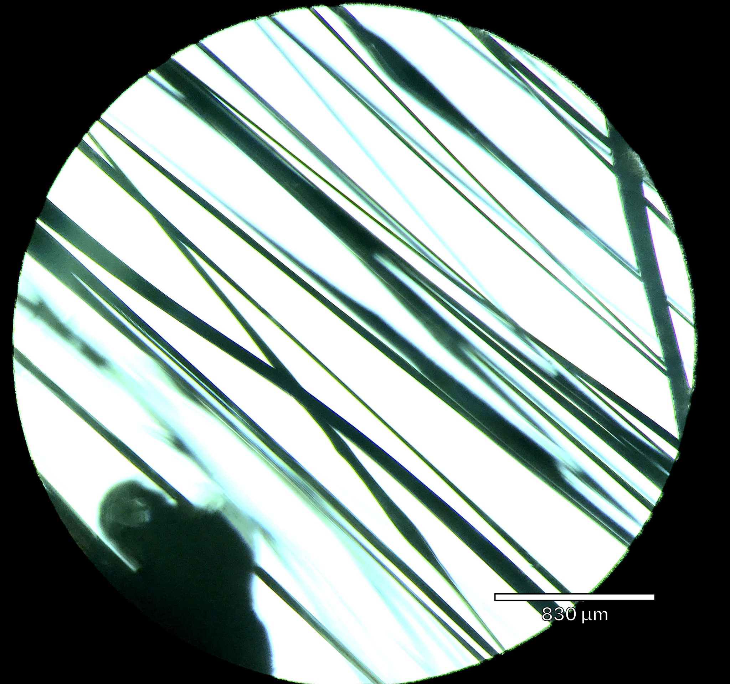
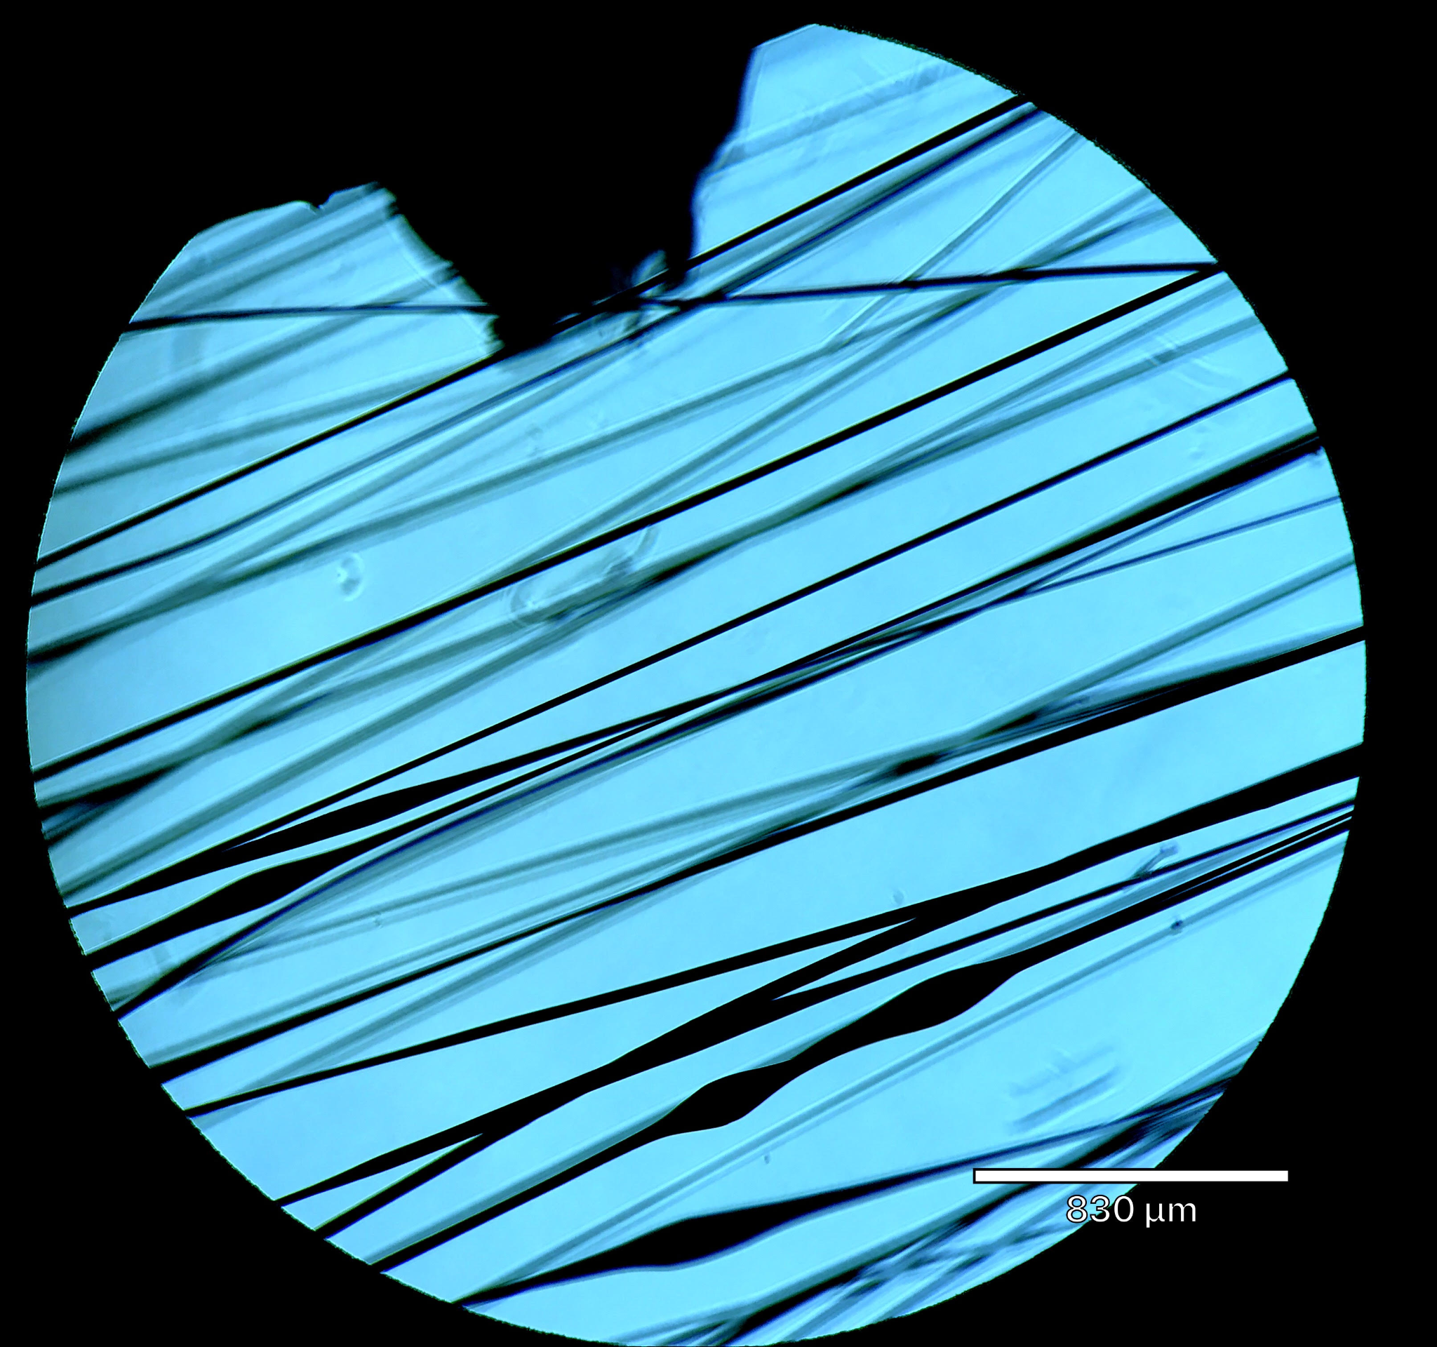
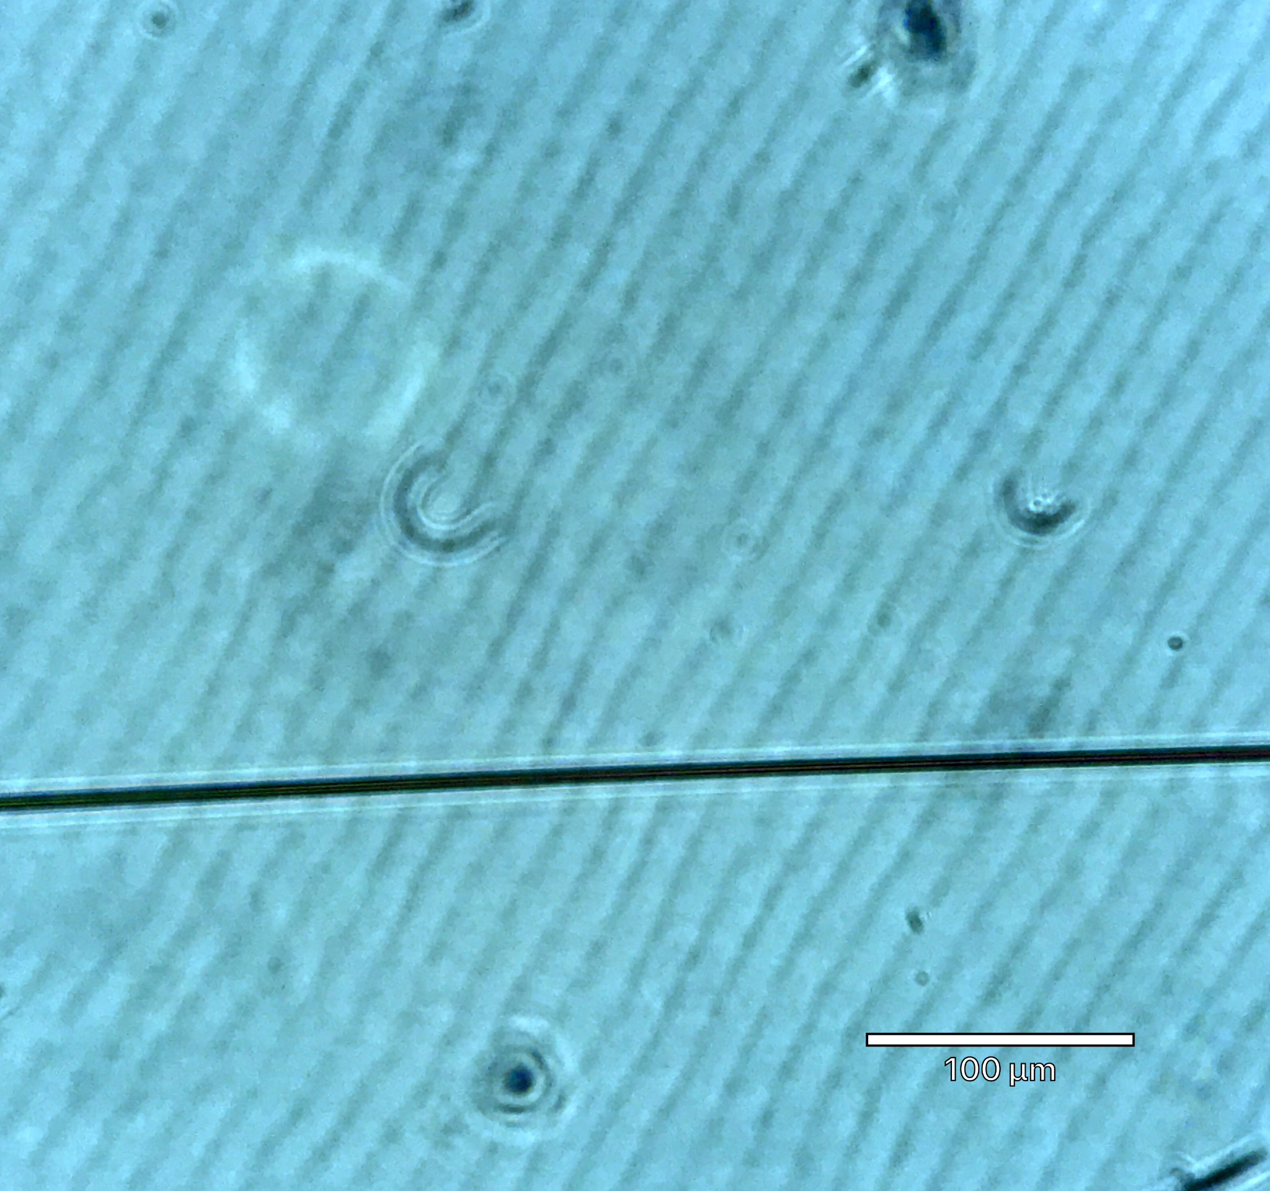
Microscopy
Fibres Should be as Uniform as Possible
Polymer-only fibres
d ~ 50 μm
Magnetic fibres, 30 wt% iron oxide
d ~ 10 μm
Introduction
Project Goals
Theory
Procedures
Results
Work To Do
‹#›
Notes:
Now let's go through some of the applications of artificial metalloenzymes. Since natural enzymes are found in a variety of exciting biotechnology applications, we can design artificial enzymes to carry out reactions that do no occur naturally, which has applications in pharmacology, medicine, sustainability and biology.

Slide 20
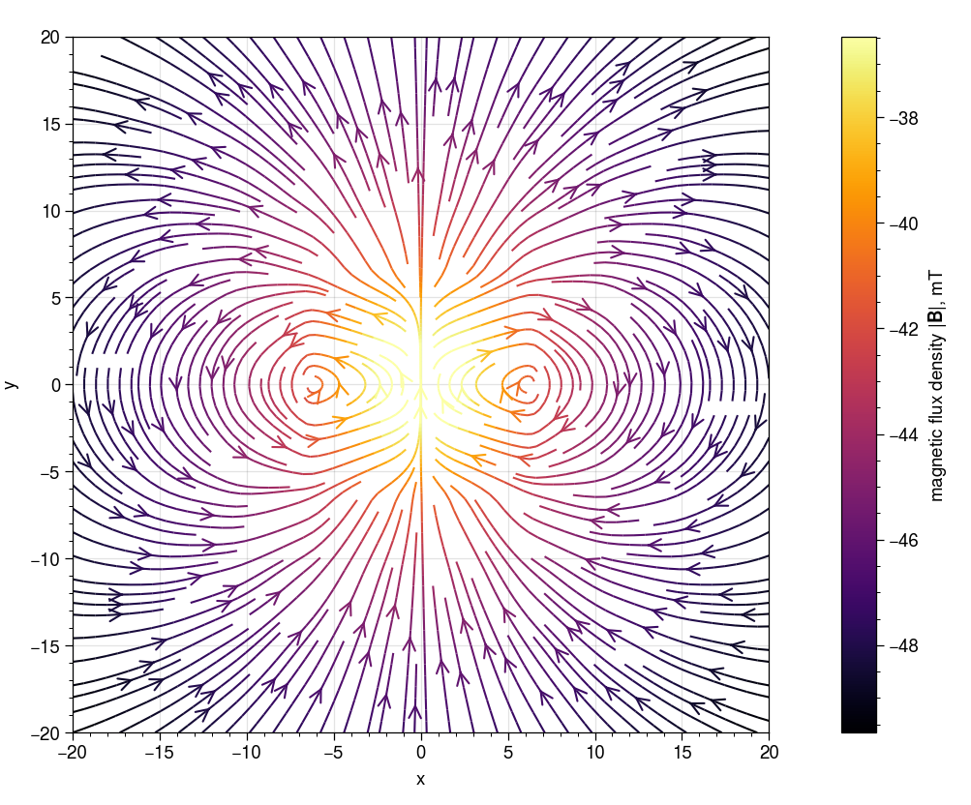
Magnetic Responsiveness
Fibres Should Deflect in a Magnetic Field
The response to a magnet was difficult to control. It was either too weak to observe or too strong, and the fibres would fall into the magnet, breaking due to their fragility.
These simple tests were performed with a permanent magnet. Going forward, an electromagnet will be used, whose field can be controlled by current input.
Analytic magnetic flux density
around a cuboidal bar magnet
Introduction
Project Goals
Theory
Procedures
Results
Work To Do
‹#›
Notes:
Now let's go through some of the applications of artificial metalloenzymes. Since natural enzymes are found in a variety of exciting biotechnology applications, we can design artificial enzymes to carry out reactions that do no occur naturally, which has applications in pharmacology, medicine, sustainability and biology.

Slide 21
Work To Do
Finish Building Extrusion Apparatus
Test More Fibre Compositions
Finalise Material Choices
Introduction
Project Goals
Theory
Procedures
Results
Work To Do
‹#›
‹#›
Notes:
So let's start by unpacking the technical terms in the title first.

Slide 22
End of Term Target
The Fibre Composition will be Selected
3D print frames that are easier to move
Set up electromagnet for formal deflection tests
Control pump syringe using Python program
Select materials for optimal fibre composition
Now ~4 lab hours ~4 lab hours ~8 lab hours
(1-2 days) (1-2 days) (2-4 days)
Introduction
Project Goals
Theory
Procedures
Results
Work To Do
‹#›
Notes:
Now let's go through some of the applications of artificial metalloenzymes. Since natural enzymes are found in a variety of exciting biotechnology applications, we can design artificial enzymes to carry out reactions that do no occur naturally, which has applications in pharmacology, medicine, sustainability and biology.

Slide 23
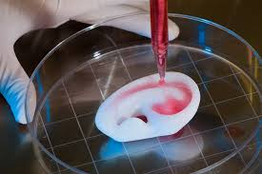
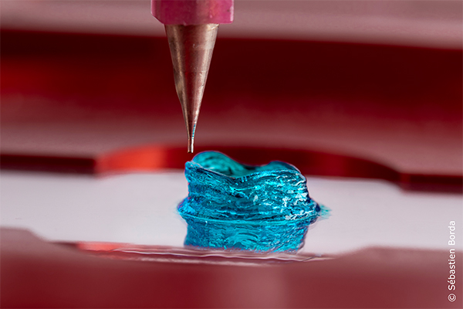
Thanks For Listening
Q & A
Introduction
Project Goals
Theory
Procedures
Results
Work To Do
‹#›
‹#›
Notes:
So let's start by unpacking the technical terms in the title first.

